Slide 1
FINDING & USING SECONDARY SOURCES EFFECTIVELY

Slide 2
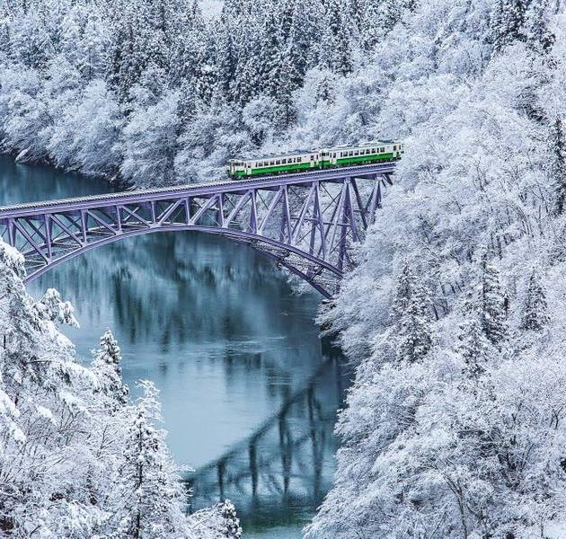
What We Will be Covering On Our Journey...
What are secondary sources?
How do I begin my research?
Where do I look?
How do I keep track of info?
Can we put theory into practice?
What happens next?

Slide 3
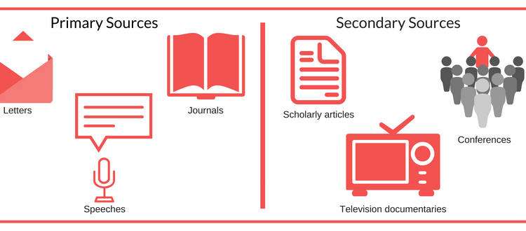




FIRST OF ALL, WHAT ARE SECONDARY SOURCES??

Slide 4

WHY DO WE NEED TO USE SECONDARY SOURCES?
Why?Why??Why??????
    because they….
    …support students’ ideas
    …help students develop critical thinking
    …allow them to practice their research skills

Slide 5
Pre-Research Information
First, ask yourself, “WHAT AM I LOOKING FOR?”. If you don’t know what you are looking for, you can spend hours and hours just “surfing”.
Review the assignment. Clearly understand what is being asked of you and make some notes as to what you will need to research.
Before you even go to the computer or bookshelf, carefully consider your topic and jot down a list of questions you will need to answer in your research. Consider the key words that will help you find the answers.
Once you go to your resources, you will need a ‘search toolbox’; a list of starter sites you can return to again and again. Iona’s databases should be included here.

Slide 6
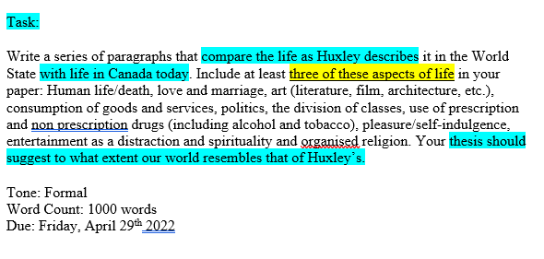
ASSIGNMENT MUST INCLUDE:
Specific observations and arguments, supported by numerous examples of evidence that connect; Huxley’s characters, ideas and themes in the novel, and your own understanding of the world in which you live. Some research and secondary sources will be required.
At least three specific passages from Huxley’s novel; punctuated and documented in proper MLA format.
Therefore, each of my body paragraphs should focus on ONE aspect of life in Canada and compare it to life as Huxley describes it. I need to include ONE primary source quotation plus ONE supporting secondary source quotation as a point of comparison in each of my body paragraphs.

Slide 7
Let’s compare the world in Golding’s Lord of the Flies with life in Canada during the Pandemic
THE ASPECTS WE WILL COMPARE WILL BE:
Life and Death – in Golding’s world, the children on the island must deal with people dying while trying to continue living; during the pandemic in Canada, numerous lives were lost as society struggled to stay safe and continue living
Division of Classes – on the island, the boys seem to organize themselves by class…a powerful group enforcing the rules on the others, a meeker group of followers, and some in the middle who try to maintain ethical order; during the pandemic in Canada, the powerful declared the rules, most of society complied and followed, but some rebelled
Entertainment as a Distraction – on the island, the children distract themselves from their dire situation by playing pretend; during the lockdowns in Canada, subscriptions to Netflix and other streaming devices skyrocketed as people distracted themselves from their bleak reality
**THE HIGHLIGHTED TERMS CAN ACT AS KEYWORDS IN OUR SEARCH FOR INFORMATION**

Slide 8
Next, we would look for secondary sources that support our ideas.
We would also go to our primary source to find quotations that support our ideas.

Slide 9
Where to Look?
Databases. They are awesome because…
…they are an electronic research option
…they contain both scholarly and popular sources
…they eliminate the need for source evaluation (the academic journal articles they carry have been peer-reviewed)
…they cite for you (just click ‘citation tools’ to choose a style)

Slide 10

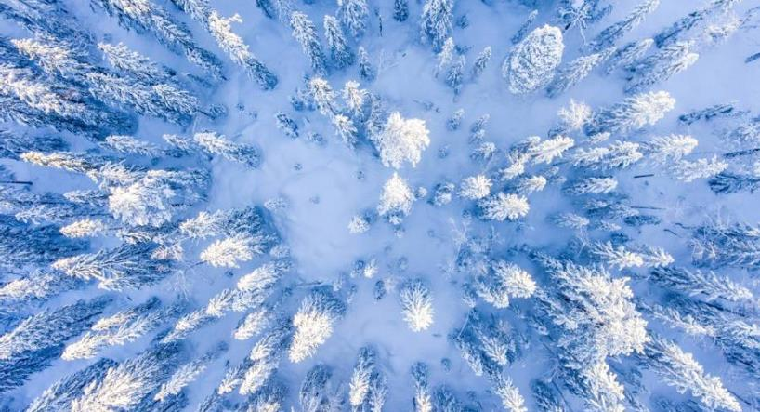
There are a few ways to access some fantastic DATABASES:
1. Through the DP dashboard
2. Through the Iona website

Slide 11
KEY PLACES TO SEARCH:
Through the DP dashboard
Through the Iona website
go to DpDashboard
select Library tile
select all secondary e-resources
browse by subject
Go to the website
Select Learning from the teal bar
Select Library from the dropdown
Scroll down to the Research section
Access the desired databases
Enter key search words

Slide 12
IF AWAY FROM SCHOOL, USE THESE PASSWORDS …
DATABASE NAME/S | USERNAME | PASSWORD
All databases | N/A | duffpeel
Britannica | duffpeel | duff7878
Infobase | ionacss | library

Slide 13
IN ADDITION TO THESE DATABASES, YOU MAY ALSO…
Go to the website
Select Learning from the teal bar
Select Library from the dropdown
Scroll down to the Research section
Select the LiveLink Websites by Subject for a large selection of different research apps
Simply follow the prompts within each App to explore the content and cite properly

Slide 14
HOW TO KEEP TRACK OF INFO?
WHEN YOU ARE CONDUCTING RESEARCH, REMEMBER TO….
Record the site/database information (record entire URL)
Keep track of successful key word searches
Record/save/bookmark citation information for useful resources
Review the brief summary or Abstract of each article before expanding it
Read the articles carefully and take point-form notes on the content
Record the day accessed for future reference and your Works Cited page

Slide 15
WHAT HAPPENS NEXT?
Compile all your point-form notes and citations
Create an outline of your essay, then turn it into a rough draft
Include your research as required in proper sentence format in your rough draft
Cite properly in the required style throughout
Carefully edit your rough draft
Type your final draft, format it (in MLA) , and include your Works Cited (as per following slides)
Proofread again! Submit!!

Slide 16
The Works Cited Page
At the end of the document, on a separate page (in alphabetical order by the author’s last name), list the works cited in creating the document.
  Give the page the title Works Cited and center the title at the top of the page applying standard capitalization rules; this page still has a Header.
  All listings should be double-spaced, with no extra spaces in between listings. The second and subsequent lines of each item should have a hanging indent (tab one time).
  List and format all sources cited by referring to the MLA Citation Guide which can be found in the library and on the school’s website. An example of a Works Cited page will follow.

Slide 17

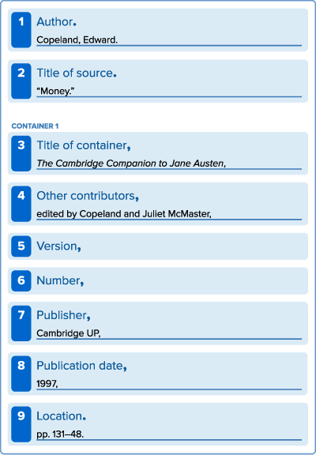
The List of Works Cited (9th Edition)
In the current model, the work’s publication format is not really considered.
Instead of asking, “How do I cite a book (or video or web page)?”, the writer creates an entry by consulting the MLA’s list of:
CORE ELEMENTS
(the facts common to most works) which are assembled in a specific order as seen in the following slide….
Core Elements Containers Practice Template
Each entry in the list of works cited is
composed of facts common to most
works—the MLA core elements.
They are assembled in a specific order.
The concept of containers is crucial to MLA style. When the source being documented forms part of a larger whole, the larger whole can be thought of as a container that holds the source. For example, a short story may be contained in an anthology. The short story is the source, and the anthology is the container.
Learn how to use the MLA practice template to create entries in the list of works cited.
template to create entries in the list
of works cited.

Slide 18
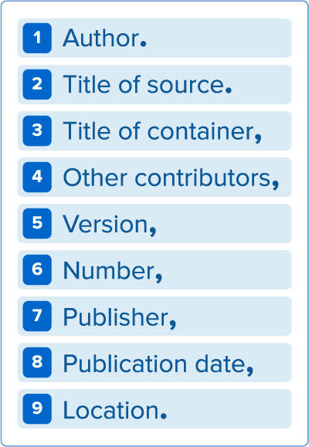
CORE ELEMENTS:
Each entry on the list of works cited is composed of facts which are common to most works—the MLA core elements.
They are assembled in a specific order, using the punctuation outlined.
Not all the elements apply to all works.
Be sure to include the date accessed at the end for online works.

Slide 19
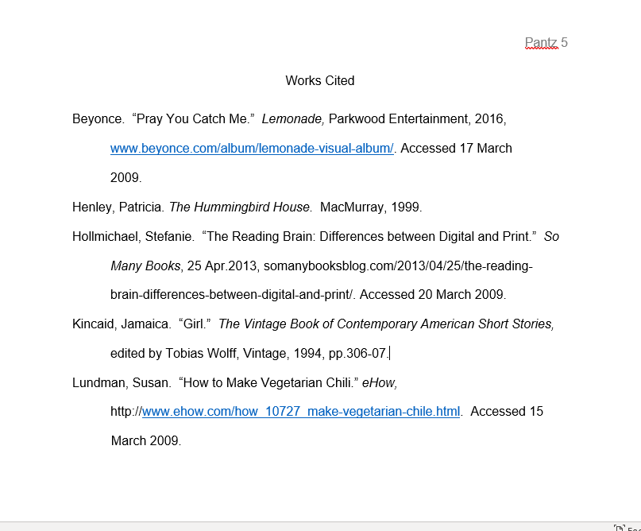
SAMPLE WORKS CITED ENTRIES USING 9TH EDITION MLA
Here are possible entries and how they should appear on a Works Cited page; a song, a novel, an online article, a short story, and a website (in that order):

Slide 20
ANY QUESTIONS??

Slide 21

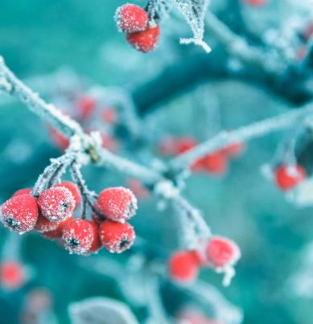

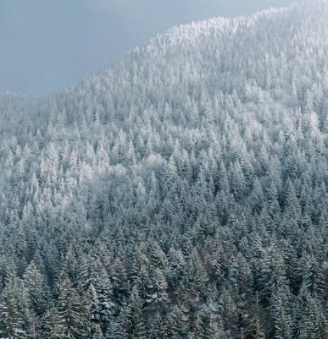
In the words of Walt Disney…
“The way to get started is to quit talking and begin doing’’

