Slide 1


EFFECTIVE NOTE-TAKING

Slide 2

As a high school student, now is the time to learn all about effective note-taking so that you have a chance to practice in high school and hit the ground running post-secondary!!

Slide 3
TOPICS WE WILL COVER TODAY
WHERE to take notes: using a laptop versus taking notes by hand
WHEN to take notes
HOW to take notes; a look at FOUR different styles
WHAT to do with your notes

Slide 4
First of all,…
WHY should we take notes?
To remember what our instructor addressed in a lesson
To recall key points for an upcoming test
To keep track of past lecture content if/when instructors ask questions about previous lessons
To help to jog memory and process information
To help with concentration and staying focused during class lectures or lessons
To summarize main ideas

Slide 5
WHERE to take notes: using a laptop versus taking notes by hand….
PRO - LAPTOP | PRO- HAND-WRITTEN
Faster than writing | Slower, but more engaging
Only good for linear structure notes | Not forced to be linear; can make charts, mind maps, etc.
Possible to fact-check during lectures | No distractions from social media or Internet
Note-taking programs like OneNote help to keep notes organized | Engaged learning=better retention
Effective for humanities | Effective for all subject areas
THERE ARE BENEFITS AND DRAWBACKS TO BOTH.

Slide 6

WHEN to take notes
before a lecture; do assigned readings & prep by recording headings and questions you might have
during a lecture, while listening to your prof
after each lecture, to clarify any vague points and consolidate what you read with what you heard

Slide 7
HOW to take notes: the different styles…
The Cornell Note-taking system
Brainstorming and Mind maps
The Outline Method for structured Note-taking
The Charting Method

Slide 8
1. The Outline Method: best for structured notes
For people who like simplicity.
One of the easiest ways to take notes; comes quite naturally to most people.

Slide 9
Formatting Your Page Using the Outline Method
A simple approach to taking notes. It helps you follow along and pay attention during class. Remember these key points:
Start by choosing four or five key points that will be covered in your lecture.
Beneath those points write some more in-depth sub-points about each topic as the professor covers them.
If taking notes by hand, leave enough space on each page so that you have plenty of room for all your sub-points.
If using a laptop, you can rearrange as you go in your text document.

Slide 10
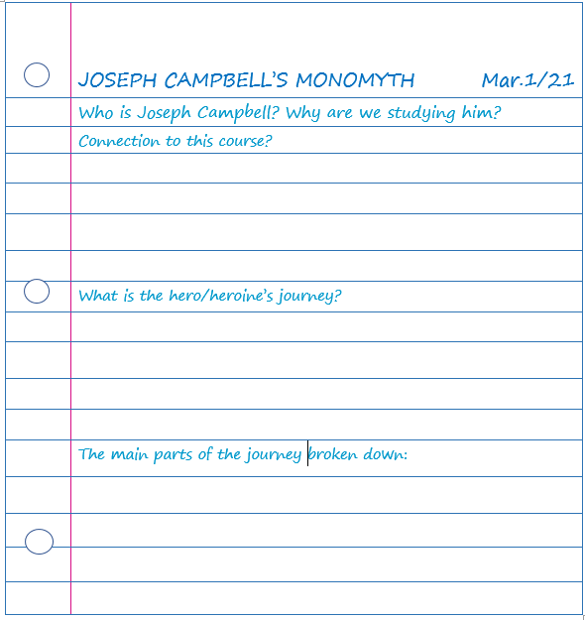
What your notes might look like using
The Outline Method….(spaces get filled in as you listen to the lecture)

Slide 11
How to use
The Outline Method effectively
Although the simplicity is appealing, there are some drawbacks to using this method for reviewing notes.
For review, read each main point and summarize it without looking too much at your notes.
Use your notes to test yourself on how much you actually know rather than simply re-reading them over and over.
Consider using the Cornell Method to help you review and learn the information you’ve taken notes on.

Slide 12
2. The Cornell Method: best for reviewing
Effective way to structure your notes if you’re looking to get the most out of your review time.
In this method, you divide your paper into three sections: notes, cues, and summary.

Slide 13

Formatting Your Page Using the Cornell Method
(AN EXEMPLAR FOLLOWS ON THE NEXT SLIDE)
First , divide your page into three columns. Grab a ruler!
Make the column on the right side of the page larger. This is where you will take your notes.
Include a smaller column on the left side of the page. This will be for any questions you formulate.
Make a small row at the bottom of the page. This section will be used to summarize your notes. You may want to highlight important key points in your notes section; then copy those notes to the bottom row as your summary.
Complete the last column after class, or later in the day to help recall important information from your lesson.

Slide 14
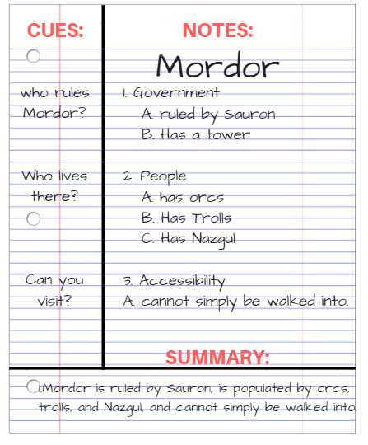
Also include the name of the task, the date, and the topic or title at the top of the page
Note the large column on the right for main notes
The smaller column on the left will be for questions or related information
The bottom section is where you summarize the day’s notes

Slide 15
3. The Brainstorming and Mind Maps
Method: best for visual learners
Good for those who like a visual representation of information and who take notes using pen and paper.
These methods use a graphic (pictorial) means of representing information. They work by relating each fact or idea to other facts or ideas.

Slide 16
Formatting Your Page Using the Brainstorming/Mind Map Method
Especially useful when taking notes from a textbook or reading because if you are reading critically, you know what is coming next and can organize your brainstorm/mind map accordingly.
To follow this method, begin in the middle of a sheet of paper.
Determine the main subject or topic. Write this title in the center of the page with a circle around it.
As major facts (subheadings) are presented that relate to the main subject/topic, draw lines out from the circle and label.
As additional facts are presented that relate to each subheading, draw these lines, linked to appropriate major fact and label.

Slide 17
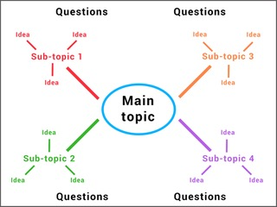
What your notes might look like using the Brainstorm or Mind Map Method:
As always, include the date, and topic/unit or title at the top of the page
Use the space around the edge of the paper to pose questions or to clarify any points you think are vague or confusing
You can also use different coloured lines to connect different thoughts.

Slide 18
4. The Charting Method: best for organizing ideas
Helpful in a Math or Chemistry class because formulae can be written in the first column, with the examples written in the subsequent columns.
For lectures where there are going to be categories that are discussed (for example, a comparison of theories in a Psychology class)

Slide 19
Formatting Your Page When Taking Notes Using the Charting Method
Lends itself well to those who prefer to take notes using a laptop because it allows you to manipulate columns and rows (add or delete) if necessary.
Determine the categories to be covered.
Set your paper up ahead of time by drawing columns with determined categories as headings for each
Place the information from the lecture in the appropriate columns.

Slide 20
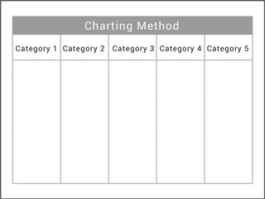
What your notes might look like using the Charting Method:
Date, and topic/unit or title go at the top of the page
If you’re unsure if the charting method may be suitable for you, consider using it when you are reviewing your notes.
Re-organizing things so that you can see the relationships not only helps you to become clearer with your understanding but shifts your knowledge from your short-term to your long-term memory, too.
Also puts things in a generally logical order, so it is easy to create comparisons and relationships.

Slide 21

Now that you are familiar with the different Note-Taking styles…
Think about how you learn best and how you are planning to use your notes later
If you choose to go the laptop route, make sure that you are backing up your notes at regular intervals (or saving them to the cloud)
If you are using notebooks, keep them organized and in a safe place

Slide 22
WHAT to do with your notes
Taking good notes is not enough; it’s what you do with them that matters…..
Review your notes within the first 24 hours after your lecture. This cements everything you heard and learned in your brain, so it won’t fall out of your head later.
Review a small portion of your notes every day. Don’t try to cram before your test. Reviewing over a long period time ensures that what you’ve learned will stick and improve your recall.
As you’re doing assigned reading or research, have your notes on hand and notice repetition. If it was covered in class and it’s in your assigned reading, there’s a good chance it’ll be used in some form of assessment.

Slide 23
AND FINALLY,
Note-taking strategies need to be learned, developed, and maintained to be successful.
INFORMATION FOR THIS PRESENTATION WAS TAKEN FROM THE FOLLOWING SOURCES:
https://www.oxbridgeessays.com/blog/master-lecture-notes-tips-really-work/
https://collegeinfogeek.com/how-to-take-notes-in-college/

